Slide 1
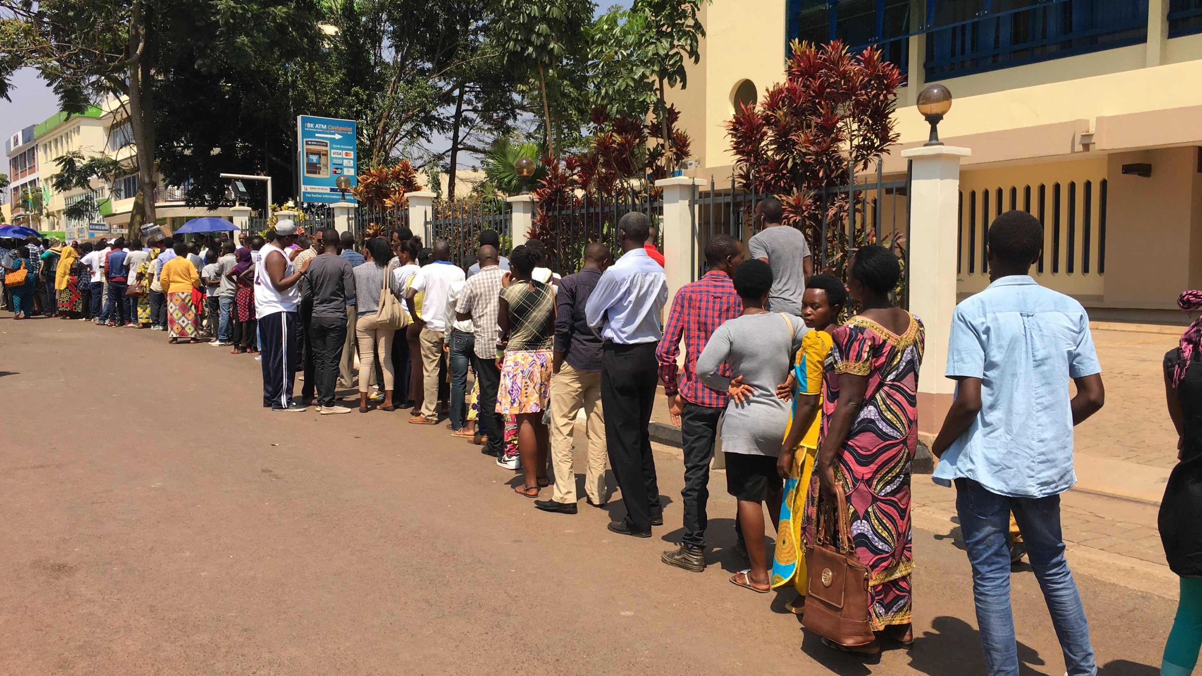

WHO Global work on transition to new treatments and formulations for Hepatitis and HIV
.
Françoise Renaud, Pharm. D, MPH
Department of HIV, Global Hepatitis Programme
MPP and UNITAID Satellite Symposium, 22nd International AIDS Conference, 24 July 2018, Amsterdam
Notes:
Good afternoon,
Thank you (Chair) for inviting us, WHO, to address this press conference.
It is indeed very important that media and journalists focus on hepatitis issues, so that policymakers and the public are provided with right information.
And in many cases, that information leads to right action and changes, so that the lives and health care for people with hepatitis C are improved worldwide.
(pause)
Today, would like to focus on two news items:
- first, I would like to share with you some core findings of the WHO progress report on access to hepatitis C treatment
- second, I would also like to share some emerging evidence and directions being considered for upcoming WHO hepatitis C guidelines.
Key messages of these two WHO products aim to inform you on where we are in delivering hepatitis C curative treatment; what are the successes and challenges we are facing.
Additionally, how a new approach for simplified treatment for all people with chronic hepatitis C, can help improve the global scale-up and move forward towards achieving global elimination goals.

Slide 2
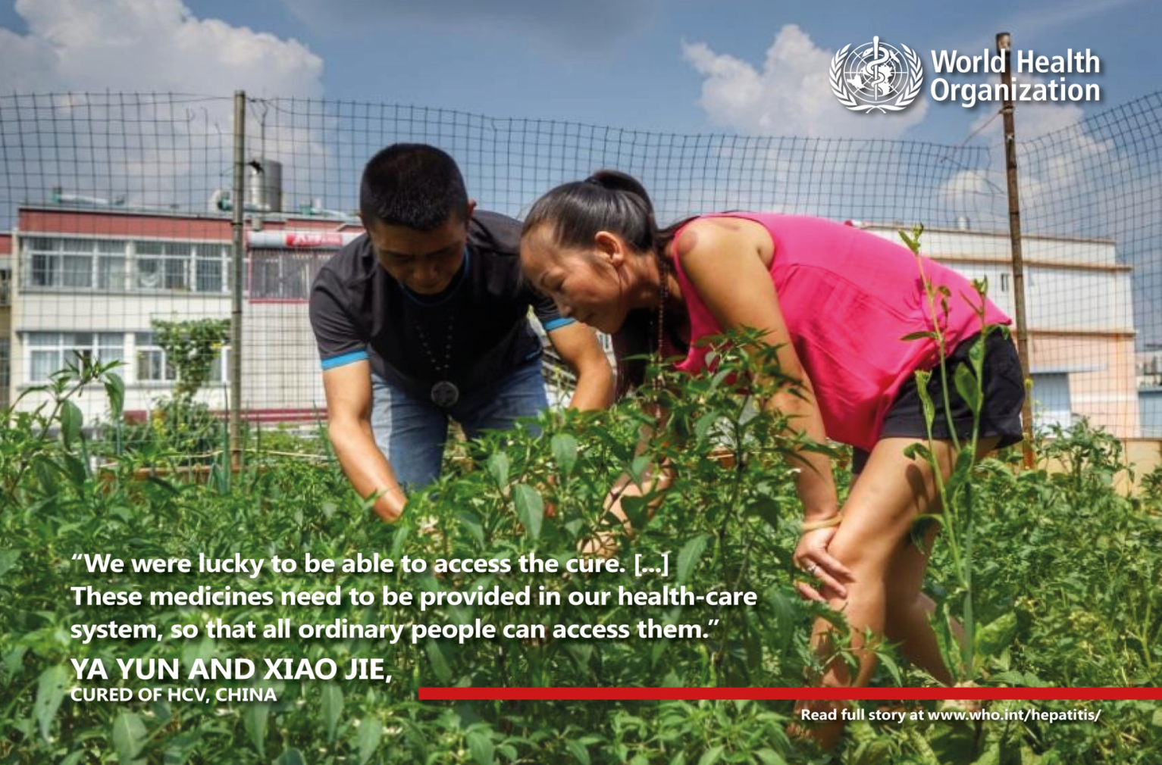
Key messages on transition to new DAAs
1. Access is increasing
but large gap persists
2. Simplification will be key
3. Create more opportunities

Slide 3
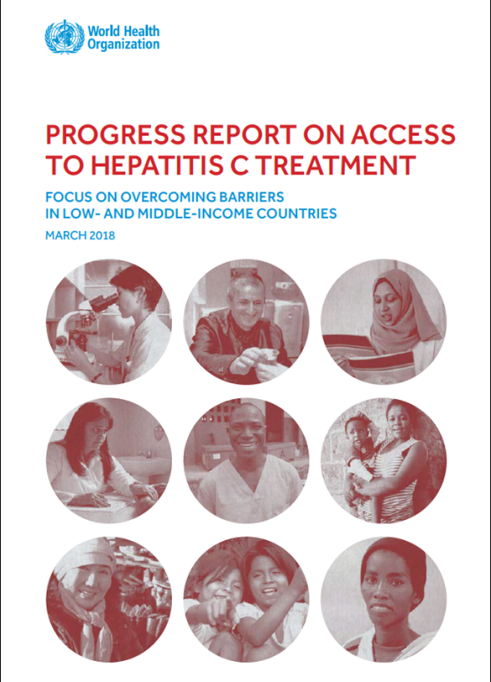
More than 3 million received curative DAA treatment by mid 2017
Access is increasing: Over 300 000 people had access to DAAs in 2014; 1 million - in 2015; 1.5 million in 2016
Countries show scale-up is possible: Egypt and Pakistan champions countries
But majority still unreached: 68 out of 71 million

Slide 4
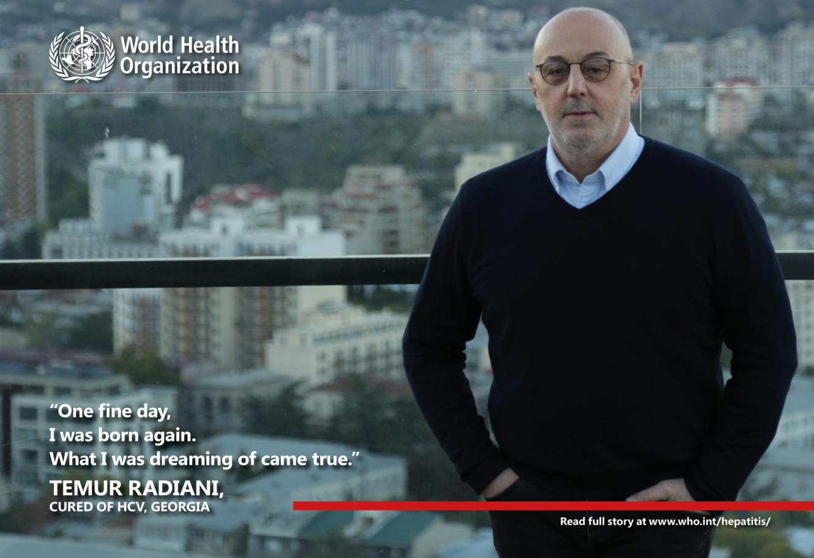
Simplification approach will be key
Simpler criteria to start treatment for all infected people above 12 years of age
Simpler treatment to cure all subtypes (no need of genotyping)
Simpler approach to procurement
Simpler service delivery models for a public health approach to Treat All

Slide 5
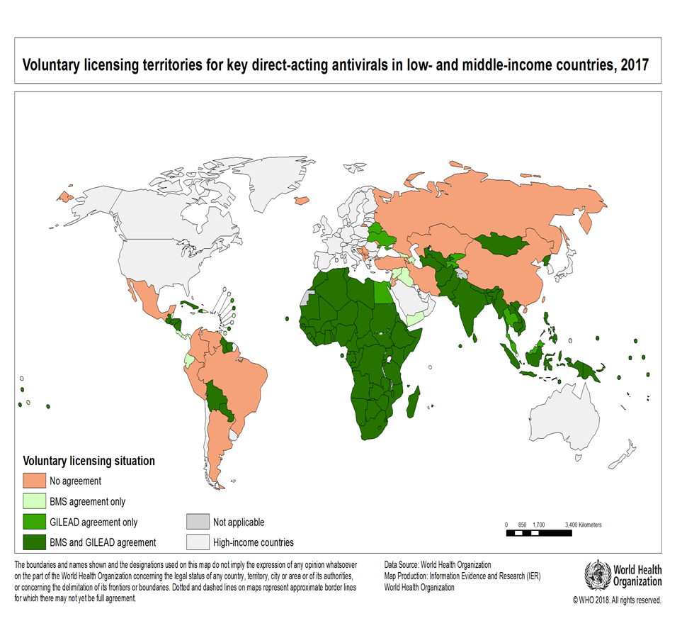
Huge opportunities already exist
62% of people living with HCV are in countries
where access of generic DAAs can and price should be less than US$200 per cure

Slide 6
Creating new opportunities
Challenges: Patent-Related Barriers
  New DAAs are broadly protected by patents and in some countries are subject to data exclusivity
    Example. Ukraine/sofosbuvir
  Using other available options
  Patents are not granted in all countries
    Example. Local production is possible incl. Algeria, Bangladesh, Egypt, Morocco
  Patent oppositions filed in some countries
    in Brazil, China, Egypt, and Ukraine

Slide 7

Creating new opportunities
Challenges: Patent-Related Barriers
  Encouraging voluntary license agreements allowing generic competition in countries
    Glecaprevir/pibrentasvir (AbbVie) – Access plan ?
    Challenge: do not help those upper-middle and high-income countries that are not included – direct negotiation or pooled procurment

Slide 8
Expanding Access to Treatment
Opportunities: Facilitating Generic Competition
  Price Negotiations
    Australia: price/volume agreement
    Latin America/Caribbean: pooled procurement
    Challenge: market transparency
  Compulsory License Agreements/Government-Use
    Allows using the patented subject matter without the authorization of the right holder
    Example. Malaysia
      Compulsory license issued to import or produce generic version of sofosbuvir

Slide 9
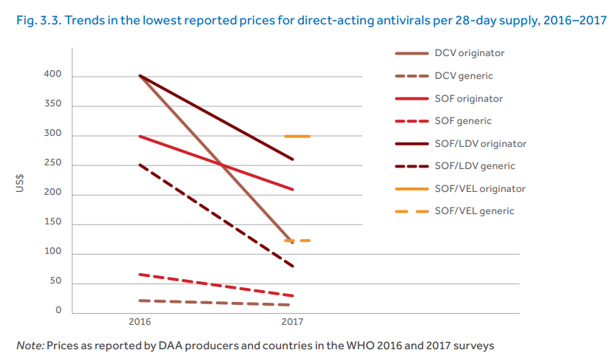
Creating new opportunities
Opportunities: Intensifying Competition to Reduce Prices

Slide 10
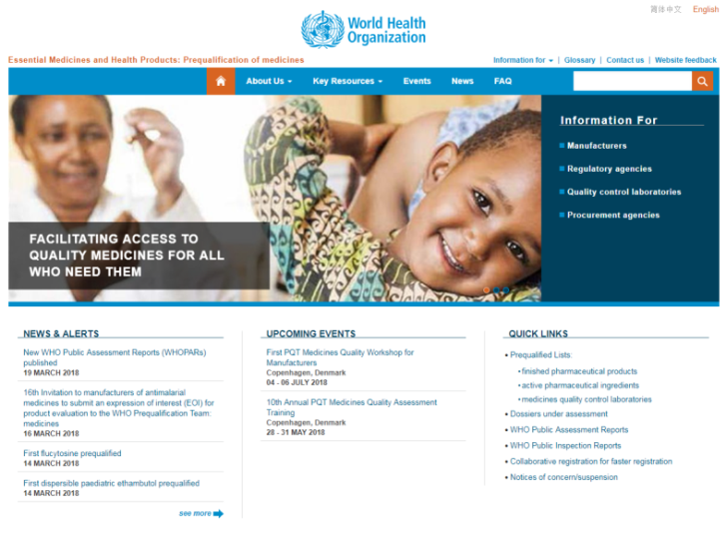
Creating new opportunities
Challenges: Prequalification/Regulatory Approval
  Accelerate regulatory approval
    Few quality-assured generic sources registered in few low- and middle-income countries
    Use Collaborative Registration Procedure
  Prequalify more treatment/diagnostic options
    Few WHO prequalified options
      Three generic sofosbuvir tablets
      Originator daclatasvir tablets
      One API for sofosbuvir
      Two rapid tests for HCV antibodies
      One HCV RNA assay

Slide 11
Overcoming Access Barriers to introduce new DAAs is Feasible
Experiences of 23 selected countries
  Lessons Learned
    Strong government responses are needed
    Market competition leads to reduced prices
    Increased financing options should be sought
    Market authorization/registration is needed
    Procurement systems could be improved
    Civil society involvement is important

Slide 12

WHO will release updated treatment guidelines on World Hepatitis Day 28 July 2018

Slide 13
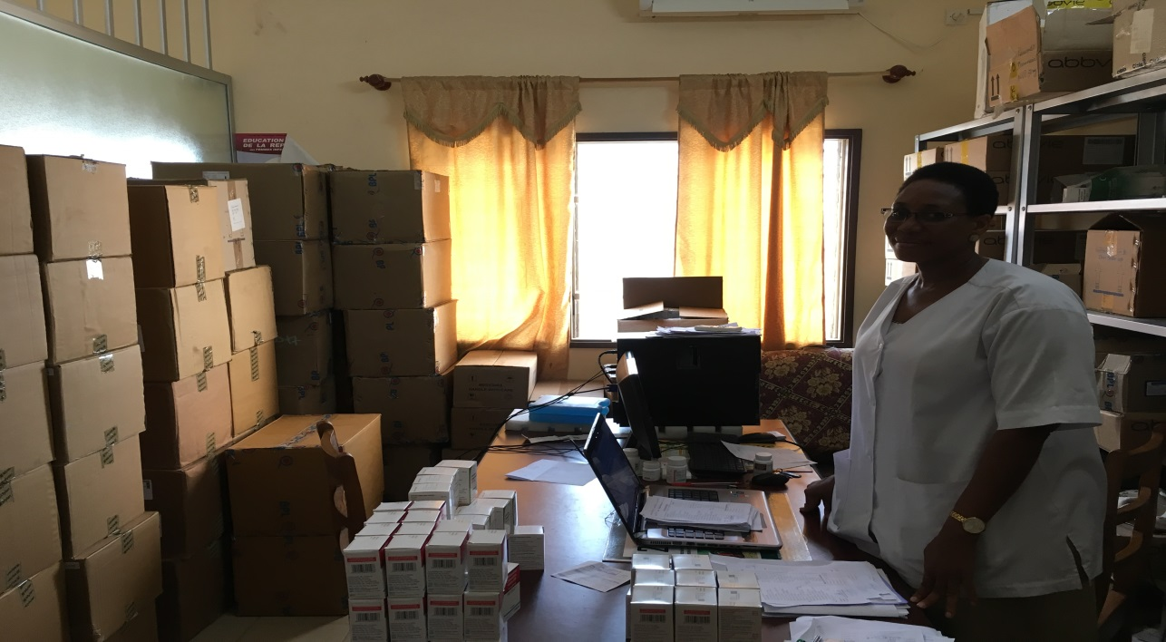
Key messages on transition to new ARVs
1. Target 2020 of 30 millions
2. Optimization is key
3. Transition plans are on-going
Notes:
Our findings support 3 key overarching messages.
(reads)
As a result, the lives of nearly 3 million people have been saved, over the last years, since the introduction of the DAAs.
In this photo, you're seeing a Chinese couple Ya Yun and Xiao Jie, who were able to access DAAs and be cured of HCV. They said:
"We were lucky to be able to access the cure. These medicines need to be provided in our health-care system, so that all ordinary people can access them."

Slide 14
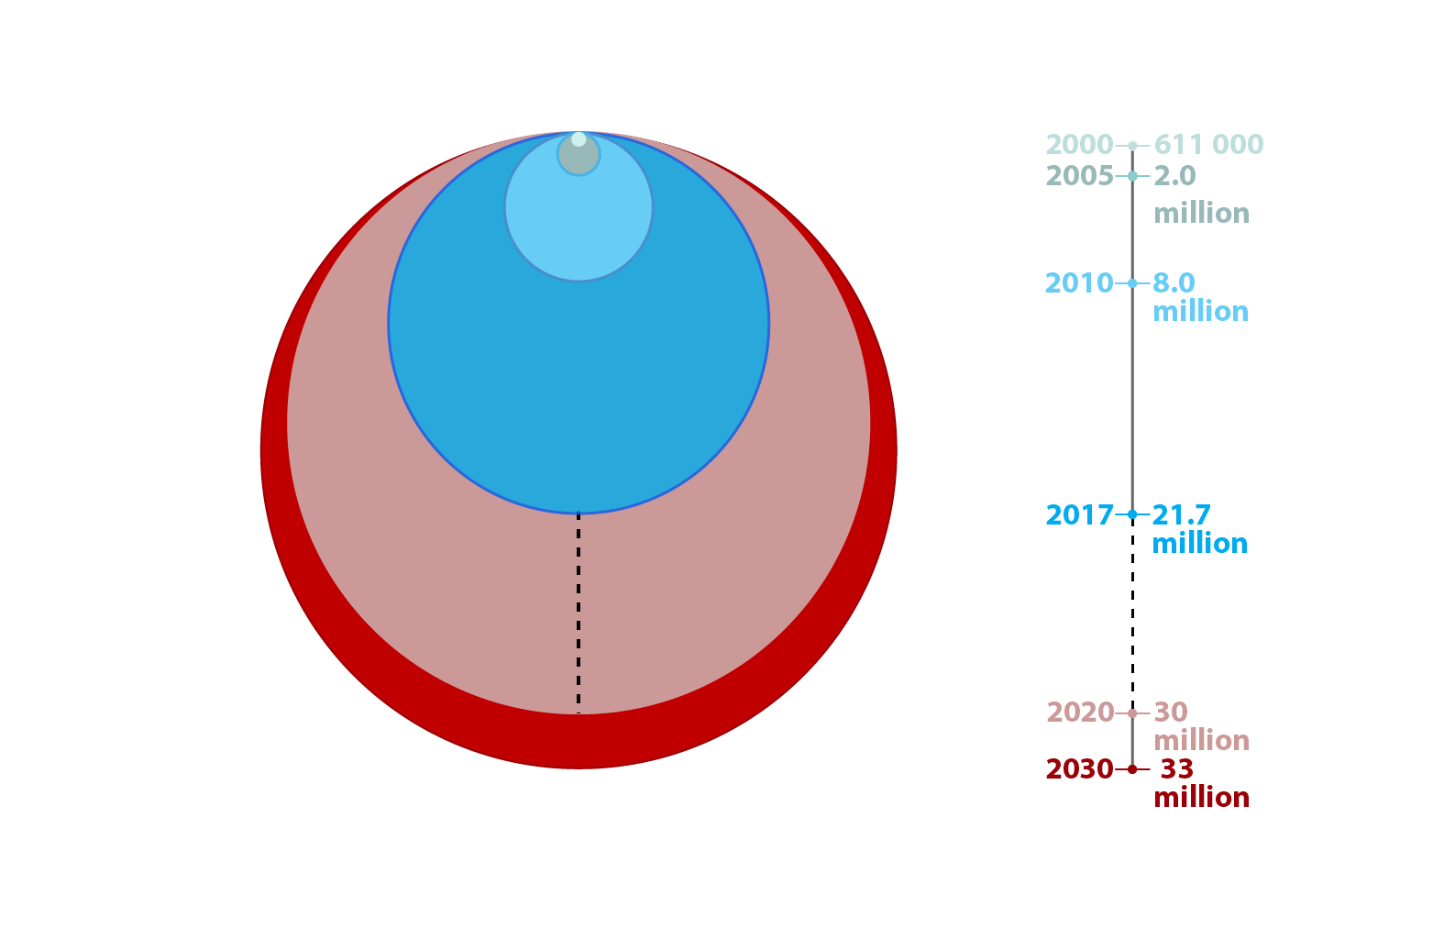
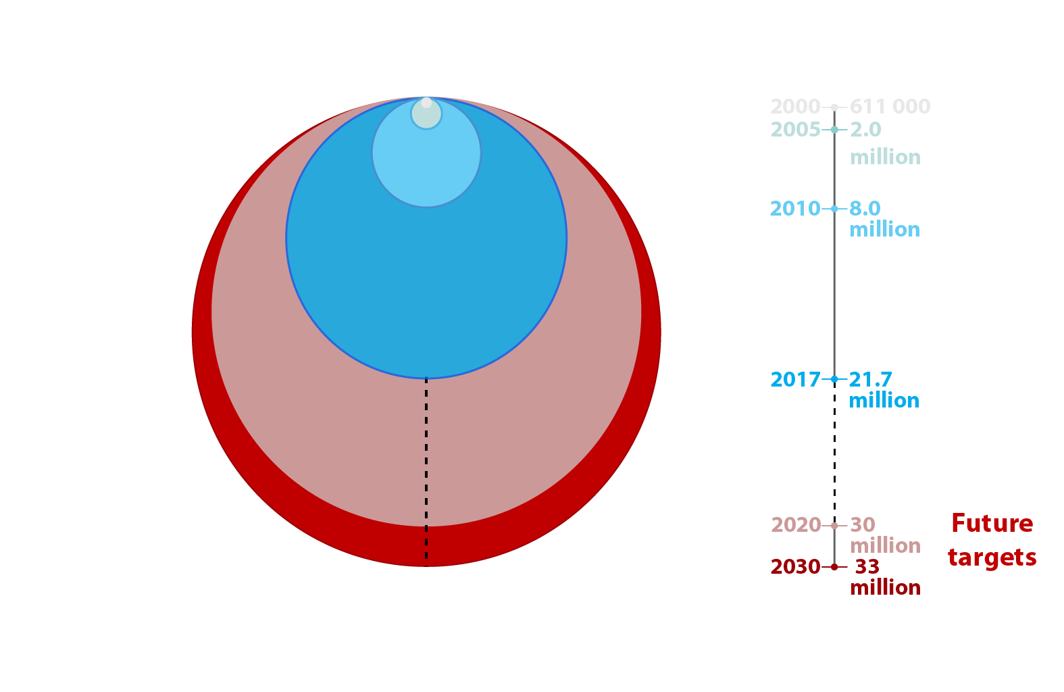
21.7 million people receiving antiretroviral treatment
40%
Source: UNAIDS/WHO estimates

Slide 15
Approach to ARV Drug Optimization: Key Principles
Reduce toxicity
Improve palatability/pill burden
Reduce drug interactions
Increase resistance barrier
Safe use across different age groups and populations (“Harmonization”)
Reduce cost → Increase availability
IMPROVE ADHERENCE TO TREATMENT
BETTER VIRAL SUPPRESSION AND HEALTH
INCREASE AVAILABILITY AND FEASIBILITY

Slide 16

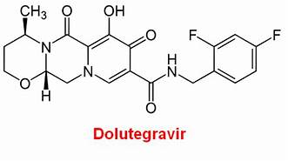
Dolutegravir – overall drug profile
Integrase inhibitor (once daily dose)
Effective (rapid viral load suppression)
Well tolerated
High genetic barrier to resistance
Few drug interactions in general adult population
Fixed dose generic formulations
Comparable price to current regimens in LMICs

Slide 17
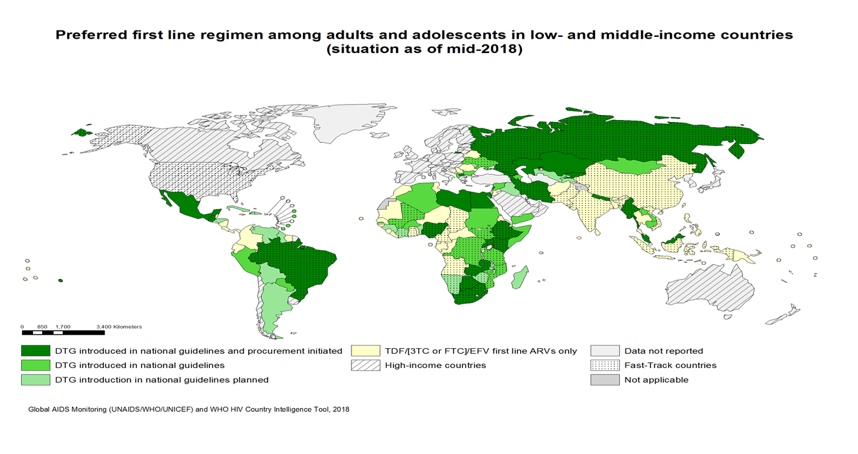
DTG uptake by countries
By July 2018, 71 LMICs (51%) informed that have included or are planning to include DTG in their national guidelines :
  DTG introduced in national guidelines: 26
  DTG introduced in national guidelines and procurement initiated: 24
  DTG introduction in national guidelines planned : 21
Approximately 500 000 PLHIV are using DTG globally
Early adoption of DTG in LMIC: Botswana, Brazil, Kenya and Ukraine
* preliminary data
*Source: GAM and personal correspondence

Slide 18
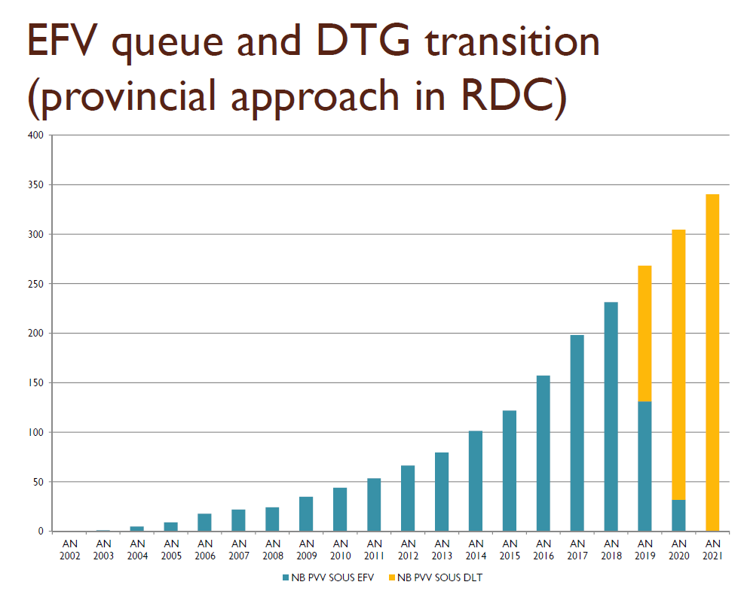
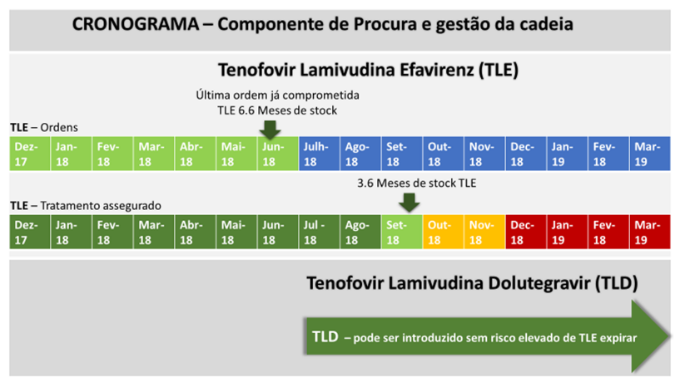
Many countries already started DTG Transition Plans
TLD transition plan in Mozambique
DTG transition plans in countries supported by PEPFAR
ARV Population and Regimen throughout TLD Transition in Eswatini

Slide 19
^{Note of caution: :} ª TLD could be considered for pregnant women identified as receiving or starting ART later in the pregnancy (second or third trimester), although the switch to TLE should be ensured after delivery in case the woman does not have access to reliable contraception. TLD can be safely used in adolescents weighing more than 30 kg.
^{b} Women should be advised on the possible effects of TLD on the pregnancy outcome and on the available contraceptive methods. Consistent and reliable contraception implies that contraceptive methods are widely available and easily accessible to the population, especially long acting contraceptive methods and dual contraceptive methods with condoms.
^{c} TLE is a safe and effective option for women desiring pregnancy or currently pregnant until the signal of potential risk of new tube defects associated with DTG use in periconception period is confirmed or refuted.
Algorithm for programmatic implementation of the new DTG recommendation – Interim 2018 guidance
People living with HIV
Male
Female
No
Yes
Desiring pregnancy or pregnant ª?
No
Yes
TLD
Access to consistent and reliable ^{b} contraception?
Yes
No
TLE ^{c}
Childbearing potential?
NEED strong partnerships to Strengthen PV programmes and patient and toxicity monitoring systems

Slide 20
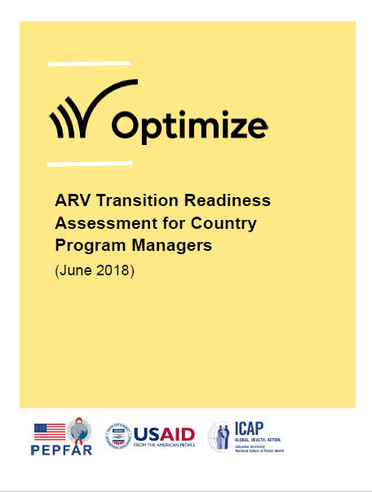
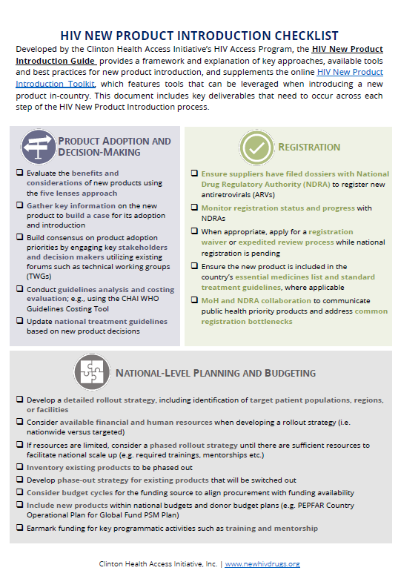
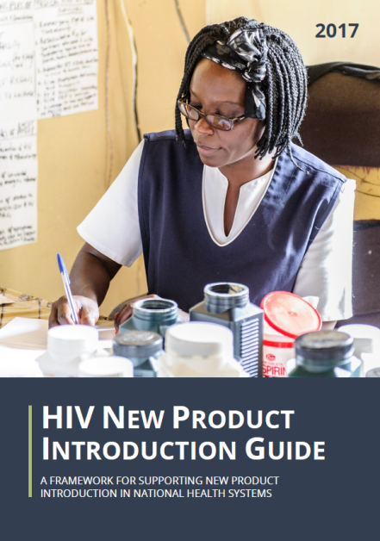
Implementation considerations for DTG transition
Consider clinical, programmatic and operational factors (eg: NNRTI PDR information, access to generic FDCs, access to contraceptive methods, training capacity of HCWs, adequate monitoring tools, EFV stock status, priority populations for phase in).
Ensure adequate supply to meet anticipated demand (phased approach recommended).
Plan drug orders with as much advance notice as possible to procurement agents and suppliers.
Ensure sufficient buffer stocks of older and new drugs throughout the transition period and beyond.
Implementation of active toxicity surveillance
Appropriate communication/messaging to communities.

Slide 21
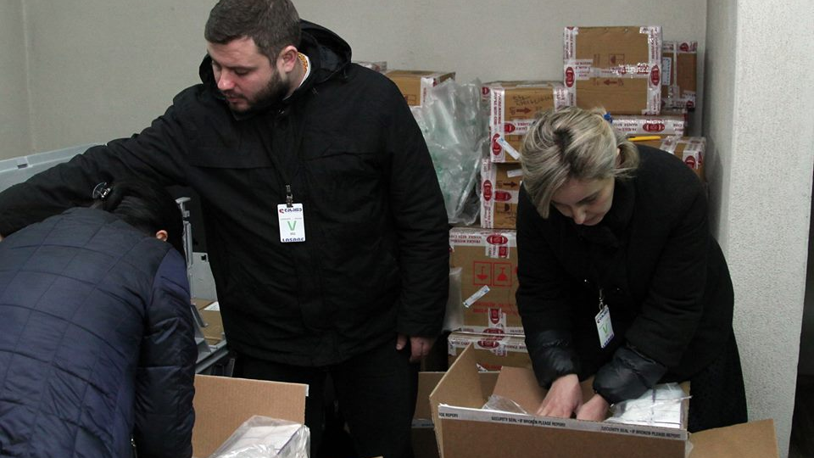
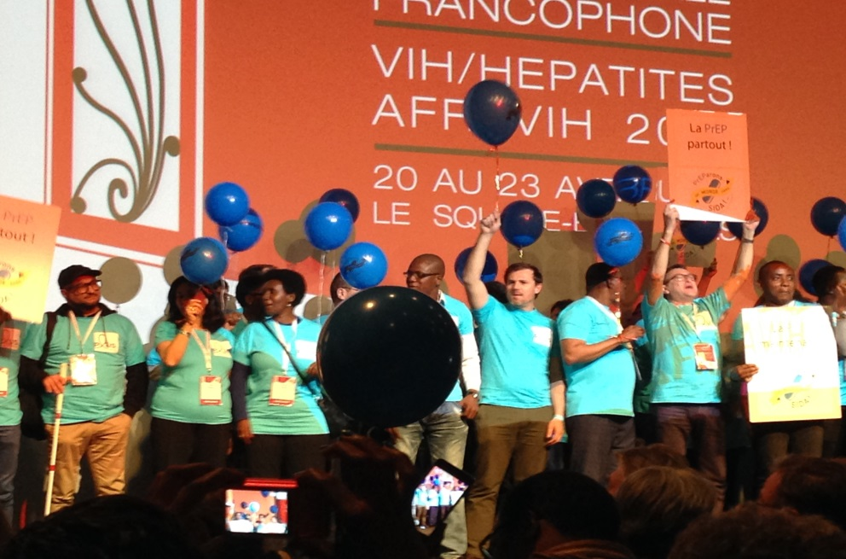
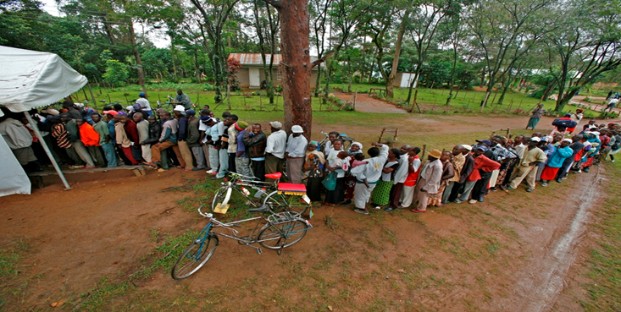
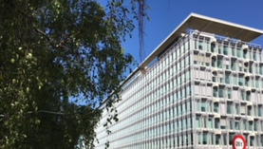
WHO is engaged in transitioning to new drugs and formulations for Hepatitis and HIV
Technical support
Technical support
Convening and working with partners
Policy and orientation

Slide 22
WHO work streams on transition plans
Policy et orientation
Technical support to countries
  Revisions of treatment guidelines
  Inclusion in model list of essential medicines
  Expansion of the prequalification programme
  Global reports on the trends in access and use of new drugs
  ART and Hepatitis national policy revisions
  Procurement issues
  PV system preparedness and toxicity monitoring
Convening partners
Costing and financing
  Researchers and partners engaged in surveillance and trials
  Regulatory authorities esp. FDA and EMA
  Manufacturers of HIV and HCV treatment: annual consultation on global forecasting demand
  Public: Media Centre, Pharmaceutical Newsletter, Technical updates , Drug Alert
Costing scenario
Using economical analysis to reduce costs
Implementing policies to overcome IP barriers
Developing financing plans (sustainability)

Slide 23
Partnerships are vital to the success of the transition to new drugs for HIV and Hepatitis
Guiding product selection aligned with Global Guidelines
Supporting programmes to transition to optimal regimens

Slide 24

WHO
20, Avenue Appia
1211 Geneva
Switzerland
Thank you!
Nicole Homb | Technical Officer | Essential Medicines & Health Products | Switzerland

