Slide 1
Accelerating the development and uptake of the most needed drug formulations for children
Monday, 23 July, 10:15-12:15
Hall 11B, RAI Amsterdam

Slide 2
Disclosure
Relations that could be relevant for the meeting | Company names
Sponsorship or refund funds | FP: No conflict to declare MW: No conflict to declare
Payment or other financial remuneration | FP: No conflict to declare MW: No conflict to declare
Shareholder rights | FP: No conflict to declare MW: No conflict to declare
Other relations
Reference: https://www.cgr.nl/CGR.nl/media/CGR.nl/Gedragscode/Format-of-disclosure-slide-for-speakers-at-refresher-training-meetings.pdf

Slide 3
Background
Market fragmentation
Lack of child
friendly formulations
Originators made possible development of paediatric formulations. Many generics developed formulations adapted to the needs.
Despite the efforts, there are products considered non-optimal (sometimes due to change in recommendations)

Slide 4
Challenges
MAIN CHALLENGES POTENTIAL SOLUTIONS
Complexity of the projects 1. Technical support and engagement with industry
Internal prioritization 2. Staging PADO priorities
Lack of market incentives 3. Financial incentives
Difficult market uptake 4. Regulatory Strategies to Support Filings
The PHTI successfully translated key PADO recommendations into projects engaging with generic manufacturers. All currently recommended paediatric and some new ARVs have been licensed by the originator to the MPP, thus allowing generic production.

Slide 5
Engagement with industry (1)
Need to engage with innovators to address or avoid:
Length of clinical trials
Sequential cohorts by age or weight bands
No WHO recommended weight-bands used
Need to engage with generics to address or avoid :
Market fragmentation and small market size overall
Lack of interest or resource to apply to development
High level of risk
Need a mechanism that channels recommendations minimising risks for generic manufacturers: PADO set the stage for priority products
PADO Staging further refines priority list
PHTI set a precedent engaging with industry

Slide 6
Engagement with industry (2)
There is need to clearly communicate priorities to industry.
PADO meeting served to fix mid- and long-term priorities that will inform the next WHO prequalification Expression of interest (EOI)
PHTI PRIORITIES BASED
ON PADO:
LPV/r 4-in-1
ALE
DTG single
DTG triple
DRV/r

Slide 7
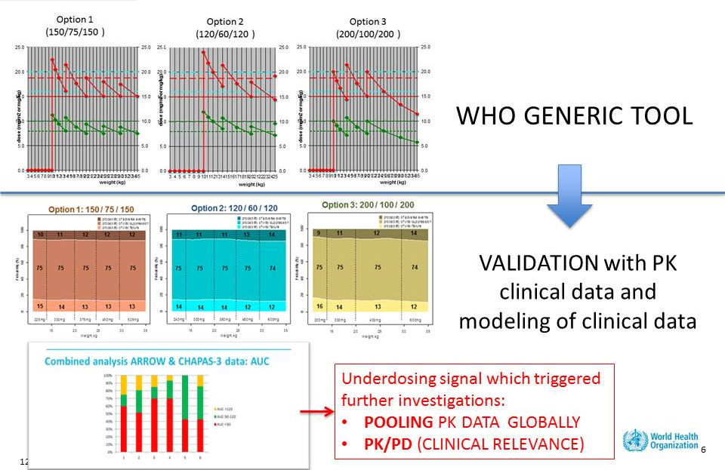
Technical support
Complexity of the projects:
  Taste masking
  FDC formulation
  Weight-band dosing
Technical support done:
  Patent situation and licensing
  Availability of clinical data
  Information on dosing per weight-band
  Information on formulation development and manufacturing
  Clinical development
  Regulatory issues
  Financing of clinical and formulation development
  Project management
  Uptake and market size

Slide 8
Staging PADO priorities
The GAP-f proposes prioritization based on product development against a set of criteria related to clinical value, impact across weight bands, timelines, and market size.
The results complement the output from PADO, but allows to stage supplier product development to more efficiently use resources and allow for forward planning.
Staging criteria:
# of 1L patients that would transition to this regimen
tolerability
FDC
# of formulations across weight-bands
# of 2L patients that would transition to this regimen
Neonates
DDI
Pill burden
…
Example based on timelines analyzed in March 2017

Slide 9
GAP-f solutions: Incentives
INCENTIVES for the development and sustainable supply of pediatric formulations, including advanced purchase commitments or other interventions
Drug Portfolio
Clinical Trial Material
Pediatric Clinical Research de novo
Product Development
Generic FDA Filing
Market Analytics
Adult Product
Approved
Product Access, Community Engagement, & Uptake
Procurement
Pharmacovigilance
STREAMLINED PAEDIATRIC DRUG DEVELOPMENT
Notes:
Prioritize product portfolio: What do we know?
Establish watching brief for new products, clinical research outcomes, evolving needs of global health
Develop an algorithm to rank opportunities against clinical, development and commercial criteria.
Communicate consistently and broadly to ensure alignment to priorities.
Generates clinical evidence that accommodates the expectations of SRAs and enables flexibility in a strategic and efficient way
Master protocol for clinical studies
Alignment of requirements and timing for PIPs and PSPs
Rapidly develops pediatric clinical trial material through contracts
Implements an aggressive strategy for product commercialization that accounts for clinical evidence, the TPP, manufacturing requirements, and market size
Draft a product commercialization plan based on available evidence that outlines risk
Launch development for those that present a viable development opportunity
Accelerates product introduction by early engagement with MOHs, primary care physicians, HCWs, and community activists
Draft product briefs, training materials and job aids
Incentivizes suppliers and coordinates procurement to catalyze uptake
Tech transfer support, development funding, market intelligence, catalytic procurement

Slide 10
GAP-f solutions: Incentives
INCENTIVES for the development and sustainable supply of pediatric formulations, including advanced purchase commitments or other interventions
Incentives could accelerate product development (technology transfer, development support, regulatory strategies), allowing shortening the timelines.
Drug Portfolio
Clinical Trial Material
Pediatric Clinical Research de novo
Product Development
Generic FDA Filing
Market Analytics
Adult Product
Approved
Product Access, Community Engagement, & Uptake
Procurement
Pharmacovigilance
STREAMLINED PAEDIATRIC DRUG DEVELOPMENT
Notes:
Prioritize product portfolio: What do we know?
Establish watching brief for new products, clinical research outcomes, evolving needs of global health
Develop an algorithm to rank opportunities against clinical, development and commercial criteria.
Communicate consistently and broadly to ensure alignment to priorities.
Generates clinical evidence that accommodates the expectations of SRAs and enables flexibility in a strategic and efficient way
Master protocol for clinical studies
Alignment of requirements and timing for PIPs and PSPs
Rapidly develops pediatric clinical trial material through contracts
Implements an aggressive strategy for product commercialization that accounts for clinical evidence, the TPP, manufacturing requirements, and market size
Draft a product commercialization plan based on available evidence that outlines risk
Launch development for those that present a viable development opportunity
Accelerates product introduction by early engagement with MOHs, primary care physicians, HCWs, and community activists
Draft product briefs, training materials and job aids
Incentivizes suppliers and coordinates procurement to catalyze uptake
Tech transfer support, development funding, market intelligence, catalytic procurement

Slide 11
GAP-f solutions: Incentives
INCENTIVES for the development and sustainable supply of pediatric formulations, including advanced purchase commitments or other interventions
Incentives to support market intelligence, catalytic procurement and market shaping, ensuring rapid uptake and minimizing risk
Drug Portfolio
Clinical Trial Material
Pediatric Clinical Research de novo
Product Development
Generic FDA Filing
Market Analytics
Adult Product
Approved
Product Access, Community Engagement, & Uptake
Procurement
Pharmacovigilance
STREAMLINED PAEDIATRIC DRUG DEVELOPMENT
Notes:
Prioritize product portfolio: What do we know?
Establish watching brief for new products, clinical research outcomes, evolving needs of global health
Develop an algorithm to rank opportunities against clinical, development and commercial criteria.
Communicate consistently and broadly to ensure alignment to priorities.
Generates clinical evidence that accommodates the expectations of SRAs and enables flexibility in a strategic and efficient way
Master protocol for clinical studies
Alignment of requirements and timing for PIPs and PSPs
Rapidly develops pediatric clinical trial material through contracts
Implements an aggressive strategy for product commercialization that accounts for clinical evidence, the TPP, manufacturing requirements, and market size
Draft a product commercialization plan based on available evidence that outlines risk
Launch development for those that present a viable development opportunity
Accelerates product introduction by early engagement with MOHs, primary care physicians, HCWs, and community activists
Draft product briefs, training materials and job aids
Incentivizes suppliers and coordinates procurement to catalyze uptake
Tech transfer support, development funding, market intelligence, catalytic procurement

Slide 12
Regulatory Strategies to Support Filings (1)
Innovative regulatory filing strategies can be developed to accelerate filings:
US FDA:
  Pre-IND consultation program
  505(b)(2) filings for formulations different to innovator formulations
WHO Collaborative Registration Procedure:
  Post WHO PQ
  If countries participate, allows for accelerated registrations at the national level
In recent years, the Indian regulatory authority, DCGI, has started to require clinical trials in an Indian population to support registration:
  This significantly complicates the development and registration pathway in India since many generic manufacturers are based in India.
  Discussions have been held, and are continuing regarding clinical data needs for pediatric populations.

Slide 13
Regulatory Strategies to Support Filings (2)
Innovative regulatory filing strategies can be developed to:
Incorporate appropriate data
Original development plan by innovator may not correspond to current needs (e.g. DRV/r):
  Depending on when clinical data was collected for pediatrics, dosing using WHO recommended weight bands may not have been collected.
  Use of modelling and simulation data to support proposed dosing
Address commonly encountered barriers
Use of Reference Listed Drugs (RLD):
  Most optimal formulations do not exist as innovator products, which complicates the development program and regulatory filing strategy.
  Agreement is needed from regulatory authorities and/or WHO PQ on appropriate RLD to use for bioequivalence studies, which in the case of US FDA, can be accomplished via a pre-IND meeting.

Slide 14
Proof of concept
Accelerate product development through incentives
  EXAMPLE OF DTG 10mg scored dispersible tablets
  Innovative public-private partnership initiative to accelerate development of optimal pediatric formulations of dolutegravir to improve the lives of CLHIV
Could also be useful downstream, to address a market failure and increase market uptake
Both awardees (Macleods and Mylan) have signed licenses with the MPP.

