Slide 1
Accelerating Access to new WHO-Recommended Generic Medicines and Formulations
Esteban Burrone and Aastha Gupta
Medicines Patent Pool
July 2018

Slide 2
CONTEXT FOR THIS SESSION
Over 90% of the HIV medicines procured in LMICs are made by generic manufacturers*, many of whom are present here today
In Hepatitis C, over 110 countries can benefit from access to generic directly acting antiviral, including some of the new pan-genotypic regimens
Some companies are vertically integrated; some specialize in active pharmaceutical ingredients or finished dosage forms only; others are primarily in tertiary production (packaging, labeling)
Public health licences negotiated by the Medicines Patent Pool have been instrumental in facilitating the development of many of the new treatments
* Waning et al Journal of the International AIDS Society 2010, 13:35; CHAI, ARV Market Report 2015

Slide 3

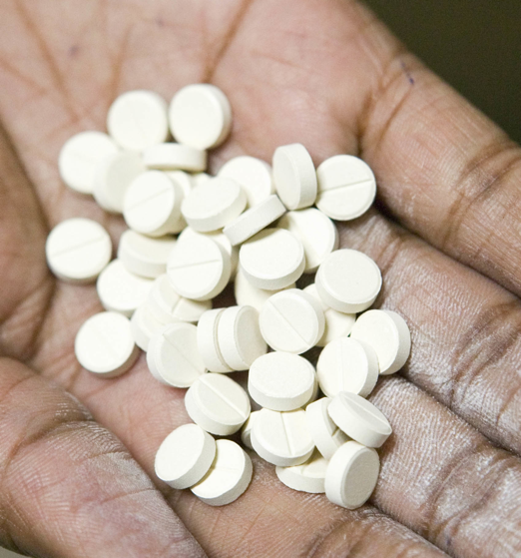
WHAT IS THE MEDICINES PATENT POOL ?
Founded in 2010 by
To increase access to new treatments for HIV through licensing of patented medicines
And facilitate innovation e.g. new fixed dose combinations and paediatric formulations
In 2015, expanded mandate to Hepatitis C and Tuberculosis
In 2018, decision to expand to other patented essential medicines

Slide 4

KEY FEATURES OF MPP LICENCES
Broad geographical scope – up to 130 countries covered in MPP licences, including large number of middle-income countries
Transparent – all licences are public
Non-exclusive to encourage competition; licensees selected through rigorous expression of interest process
Strict quality assurance (WHO PQ, SRA or ERP)
Faclitate development of new fixed dose combinations and paediatric formulations
Complementary to other access programs and strategies

Slide 5

HOW TO FIND OUT WHICH COUNTRIES ARE IN LICENCES OR HAVE PATENTS ON AN ESSENTIAL MEDICINE
Most comprehensive source of information on the patent and licensing status of essential medicines in low and middle income countries
Patent status data from over 110 low and middle income countries
Data exclusivity information from 15 countries
Covering approx. 70 medicines (over 130 formulations)
Information on relevant licences
www.medspal.org

Slide 6





A stylized view of the mpp model
PEOPLE NEEDING ACCESS TO MEDICINES IN DEVELOPING COUNTRIES
PATENT HOLDERS
GENERIC MANUFACTURERS
Sub-
Licences
Licences
Medicines
ROYALTIES
The MPP is funded by

Slide 7
A stylized view of the mpp model
PEOPLE NEEDING ACCESS TO MEDICINES IN DEVELOPING COUNTRIES
PATENT HOLDERS
GENERIC MANUFACTURERS
Sub-
Licences
Licences
Medicines
ROYALTIES
Objective of today’s session
The MPP is funded by

Slide 9
UNPRECEDENTED SPEED IN MAKING NEW ARVS AVAILABLE IN LMICS
THE CASE OF DOLUTEGRAVIR
August 2013: DTG approved by US FDA
June 2016 WHO guidelines recommend DTG in 1st line
Sept 2017
Price of USD 75 announced for TLD combination
2013
2014
2015
2016
2017
April 2014: MPP license with ViiV Healthcare
November 2016:
First MPP licensees filed for WHO Prequalification
August 2017: First approval of new combination (TLD) from MPP licensee
4 years from originator approval to availability of a new fixed dose combination (“TLD”) from multiple suppliers at affordable prices

Slide 10












MPP’s Partnership with Patent Holders
Lopinavir
Ritonavir
(separate paediatrics and adults licences)
Atazanavir
Daclatasvir (HCV)
Nevirapine
(non-assert)
Bictegravir
Cobicistat
Elvitegravir
Emtricitabine
Tenofovir Alafenamide
Tenofovir Disoproxil
Darunavir (paed) (non-assert)
Sutezolid (TB)
Raltegravir (paed)
Darunavir related
Ravidasvir (HCV)
Valganciclovir (pricing agreement)
Solid drug nanoparticles technology for HIV
Abacavir (paed)
Dolutegravir (paed)
Dolutegravir (adults)

Slide 11
Snapshot of MPP Sub-Licences
94 sub-licences with 24 manufacturers; 140+ active projects
*MOU executed

Slide 12
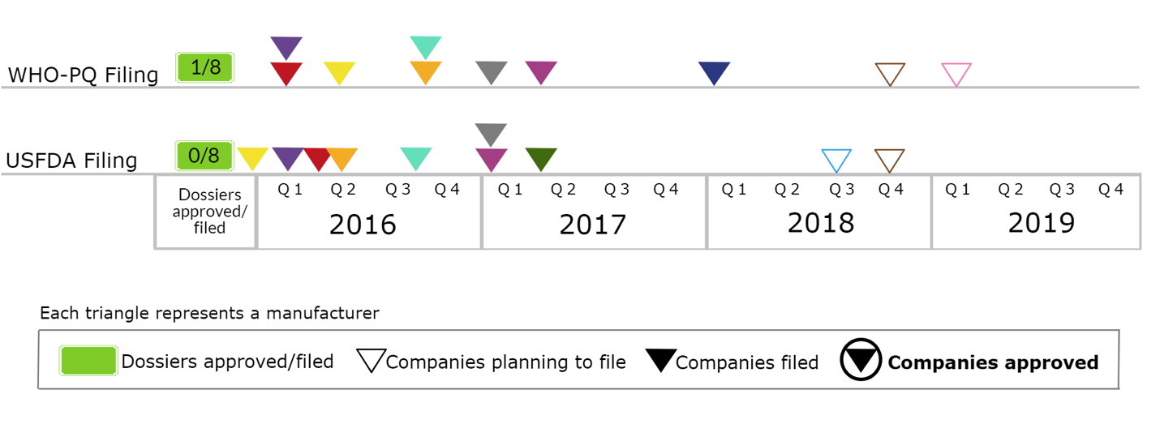
Triangle Charts: A Snapshot
Triangle charts represent a comparative analysis of each MPP licensee on filings with USFDA and WHO-PQ for each product
See following slides for explanation

Slide 13
Triangle Charts Explained (1/5)
Filing of generics with
WHO-PQ and/or USFDA

Slide 14
Triangle Charts Explained (2/5)
No. of companies that received approval out of total companies filed with WHO/SRA

Slide 15
Triangle Charts Explained (3/5)
Outlined triangles () represent licensees planning to file
Each colored triangle corresponds to a different licensee

Slide 16
Triangle Charts Explained (4/5)
Triangle charts represent a comparative analysis of each MPP licensee on filings with USFDA and WHO-PQ for each product
Filled triangles () represent licensees who have filed

Slide 17
Triangle Charts Explained (5/5)
Triangle charts represent a comparative analysis of each MPP licensee on filings with USFDA and WHO-PQ for each product
A circled triangle represents a licensee who has received approval

Slide 18
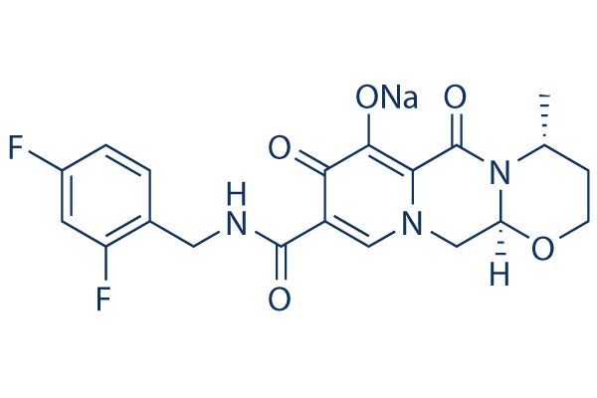
Dolutegravir

Slide 19
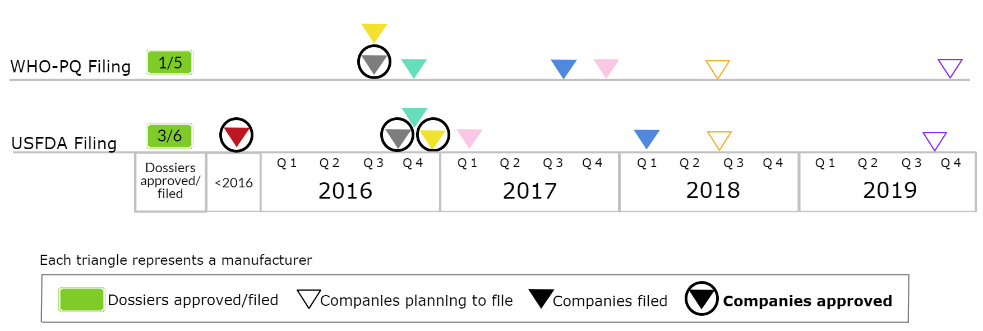
DTG 50mg
The above chart shows 8 MPP licensees are developing DTG 50mg, of which:
  5 companies have filed with WHO-PQ; of which Cipla has received approval
  6 companies have filed with USFDA; of which Aurobindo, Cipla and Mylan have received approvals
Hetero and Emcure have received ERP approvals
In total, 5 companies are ready to supply DTG 50mg

Slide 20
DTG 50mg: Country-wise Filing Status
Approved (9) 22.1% PLHIV
Botswana
Côte d'Ivoire
India
Kenya
Nicaragua
Myanmar
Tanzania
Ukraine
Uzbekistan
Filed (24) 66.4% PLHIV in LMICs
Burundi | Kyrgyztan | Senegal
Congo | Malawi | Sierra Leone
DR Congo | Mauritius | South Africa
El Salvador | Mozambique | Sudan
Ethiopia | Namibia | Uganda
Gabon | Nigeria | Vietnam
Ghana | Pakistan | Zambia
Guyana | Rwanda | Zimbabwe
Generic DTG has been filed in 33 countries, of which approval is received from 9
Another 30 filings are planned for 2018 (covering an additional 11.5% PLHIVs in LMICs)

Slide 21
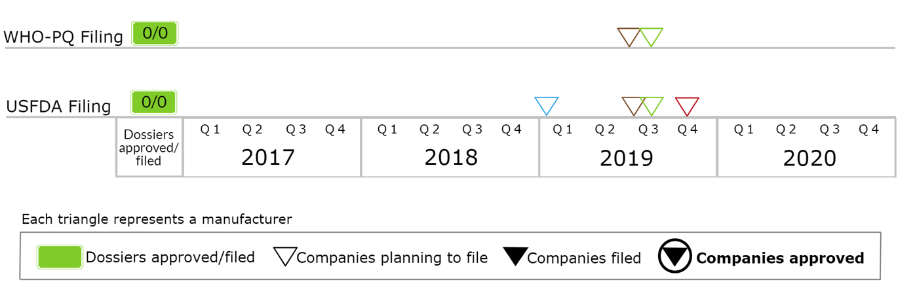
DTG 50mg Dispersible Tablets
Four MPP licensees are developing DTG dispersible formulation, of which:
  2 plan to file with WHO-PQ in Q3-19
  1 plans to file with USFDA in early 2019 and another 3 by second half of 2019

Slide 22
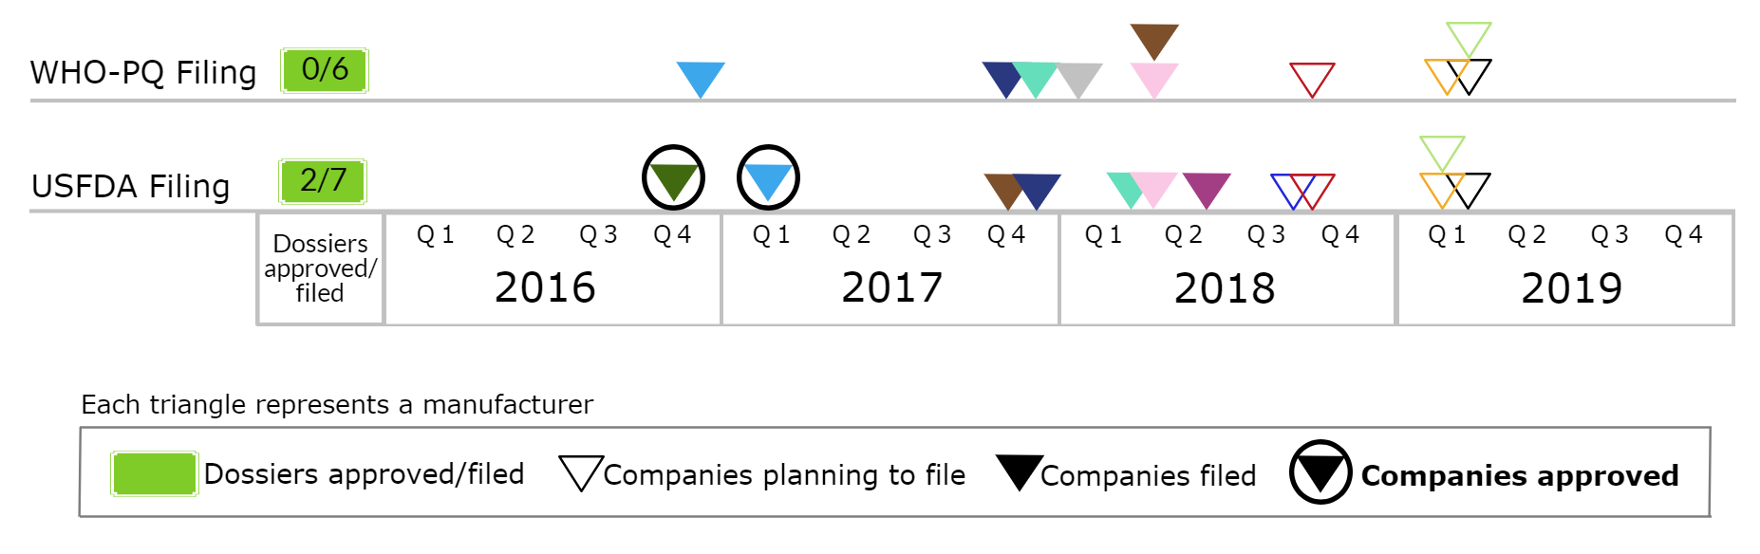
TDF/3TC/DTG
(tenofovir disoproxil/lamivudine/dolutegravir)
13 MPP licensees are currently developing TDF/3TC/DTG, of which:
  6 have filed with WHO-PQ
  7 have filed with USFDA; of which Mylan and Aurobindo have received approvals
Cipla, Hetero, Macleods, and Sun have received ERP approval
In all, 2 generic versions of TLD are already in the market and an additional 4 are expected to be launched soon

Slide 23
TDF/3TC/DTG: Country-wise Filing Status
Approved (6) (19.4% PLHIV in LMICs)
Botswana
Côte d'Ivoire
India
Kenya
Malawi
Uzbekistan
Filed (25) (69.2% PLHIV in LMICs)
Benin | Ghana | South Africa
Burkina Faso | Madagascar | Tanzania
Burundi | Mali | Uganda
Cameroon | Mozambique | Ukraine
Congo | Namibia | Vietnam
DR Congo | Niger | Zambia
El Salvador | Nigeria | Zimbabwe
Ethiopia | Rwanda
Gabon | Senegal
Generic TLD has been filed in 31 countries, of which approval is received from 6
Another 25 filings are planned for 2018 (covering an additional 7.7% PLHIVs in LMICs)

Slide 24
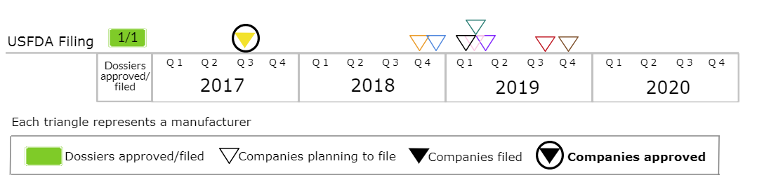
TAF/FTC/DTG
(Tenofovir alafenamide/emtricitabine/dolutegravir)
Due to lack of clinical data, TAF is not on the WHO Guidelines as of now. However, generics have already started developing TAF combinations
10 MPP licensees are developing TAF/FTC/DTG, of which:
  Mylan has filed with USFDA and received approval
  2 additional filings are planned by end of 2018
We anticipate development by additional licensees accelerate once there is an update on WHO’s position about use of TAF-containing formulations

Slide 25
Paediatric HIV

Slide 26
Paediatric Projects¹
LPV/r
(sprinkles in sachet or minitabs in capsule)
Three companies working on this product:
  Cipla has received USFDA approval
  Another has filed with WHO-PQ and USFDA in Q1-18
  The third plans to file with USFDA and WHO-PQ in Q3-19
LPV/r/ABC/3TC
(sprinkles in sachet or minitabs in capsule)
Three companies working on this product:
  One plans to file with USFDA and WHO-PQ in Dec-18
  Another plans to file with USFDA and WHO-PQ in 2019
  Another developing, filing status and plans unknown
ABC/3TC/EFV
Three companies working on the product
  Filing plans in 2019
ABC/3TC/DTG
Multiple companies interested in development, awaiting WHO recommendation on dosage

Slide 27
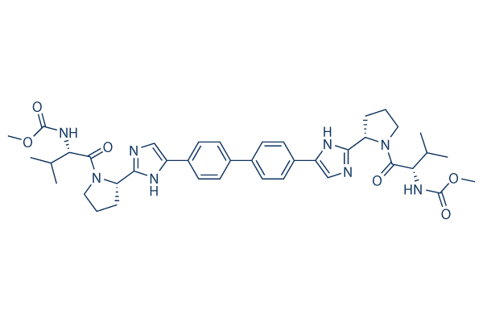
Daclatasvir

Slide 28
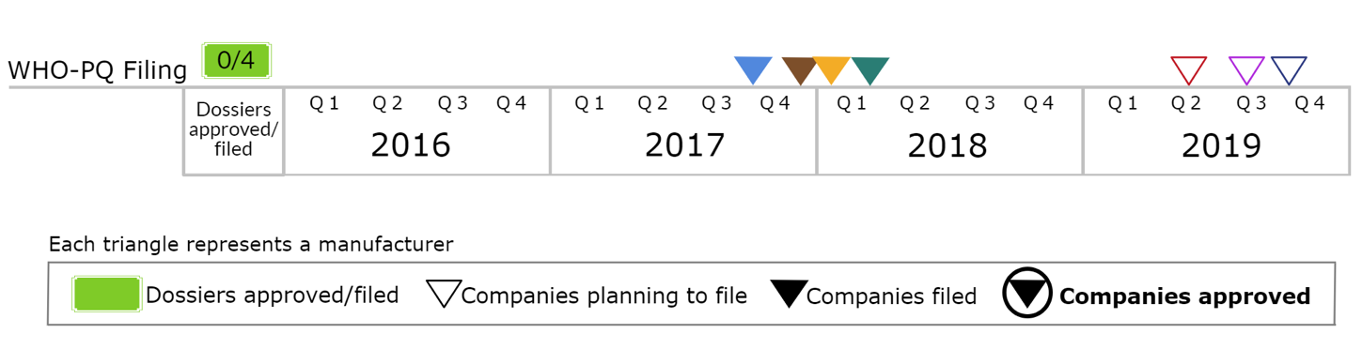
DAC 30mg and 60mg
Seven MPP licensees are currently developing the two products, of which:
  4 have filed with WHO-PQ
  3 filings planned in 2019
Hetero has received ERP approval
Currently approved in 16 countries and filed in another 30 countries

Slide 29
DAC 30mg & 60mg: Country-wise Filing Status
Approved (16)
Cambodia | Indonesia
Chad | Malawi
Congo | Mongolia
DR Congo | Myanmar
Ethiopia | Nicaragua
Gabon | Pakistan
Guyana | Turkmenistan
India | Uzbekistan
Filed (30)
Azerbaijan | Ghana | Rwanda
Benin | Guatemala | Senegal
Bolivia | Haiti | Sri Lanka
Botswana | Kenya | Sudan
Burkina Faso | Lao PDR | Suriname
Burundi | Namibia | Tanzania
Cameroon | Nepal | Uganda
Côte d'Ivoire | Nigeria | Vietnam
Dominican Republic | Paraguay | Zambia
Generic DAC has been filed in 46 countries, of which approval is received from 16

Slide 30
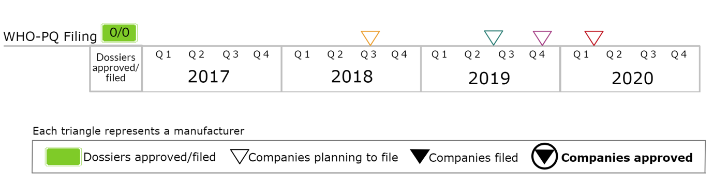
DAC/SOF
Currently 4 MPP licensees are developing DAC/SOF combination, of which:
  First filing with WHO-PQ is expected in Q3-18
  Another three companies plan to file in the next year
Currently approved in 3 countries and filed in another 14 countries

Slide 31
DAC/SOF: Country-wise Filing Status and Plan
Approved (3)
India
Libya
Uganda
Filed (14)
Dominican Republic | Paraguay
Ghana | Suriname
Ethiopia | Vietnam
Kenya | Zambia
Namibia | Myanmar
Guyana | Nicaragua
Nigeria | Zimbabwe
DAC/SOF has been filed in 17 countries, of which approval is received from 3
Notes:
updated

Slide 32
MPP Impact

Slide 33
Impact of MPP Agreements Till Dec-2017
(HIV, HCV products)
128 Countries
146 New instances of countries
MPP licensees distributing generics
Benefitted from generic competition through MPP agreements
$553mn
89% average drop
Savings
In formulation prices after MPP agreements
17mn Patient-years
Serviced by MPP licensees
Review and independent assurance of impact by KPMG*
* Available at: https://medicinespatentpool.org/uploads/2018/06/Final-MPP-Statemen.pdf

Slide 34
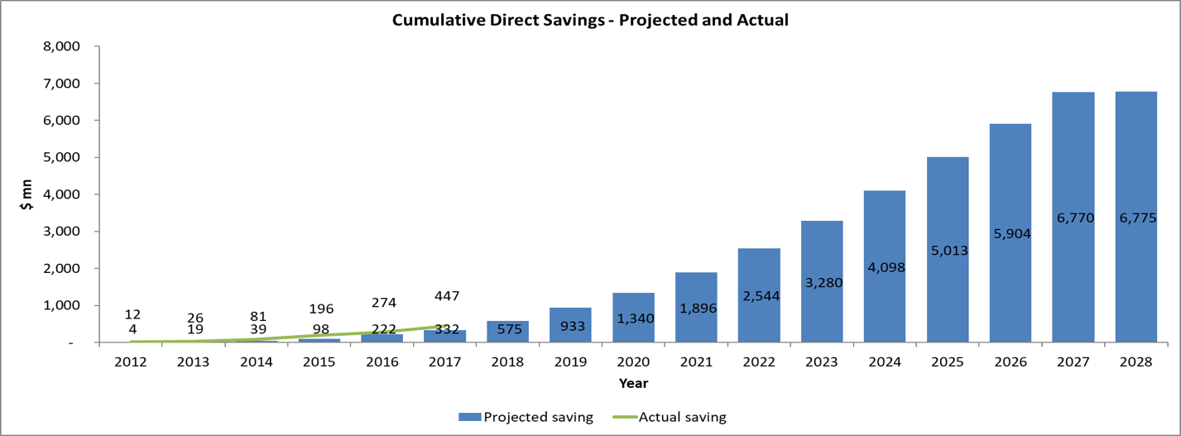
Projected Impact of MPP HIV Agreements Till 2028
(HIV products only)
The economic model projects the MPP will generate $6.8 billion in direct savings by 2028
$6.8 billion
Total Direct Savings for Net Impacted PLHIVs in Expanded Territories
$433 million*
Total Direct Savings for Net Impacted PLHIVs in Expanded Territories till Dec-2017
1:130
Cost-Benefit Ratio of MPP Operating Budget to Direct Savings
* Calculation of actual impact (from data received by sub-licensees)

Slide 35
The MPP’s HIV, TB and hepatitis C activities are fully funded by:

Slide 36

Thank you
www.medicinespatentpool.org
www.medspal.org
@MedsPatentPool

